Slide 1
Reward Shaping with LSTM

Slide 2
Dataset
Dataset
30 Subjects
Skeleton-based Kinect Data
75 Features per Frame
Sliding Window Technique
Window Parameters:
Window Size = 64
Stride = 16
Generated Samples:
Total Windows = 7395

Slide 3
Data Preprocessing for Training and Testing
A)Window-wise split:
→In window-wise splitting, the generated windows are randomly divided into training and testing sets.
Suppose the dataset contains: 100 Total Windows
Training Set = 70 Windows Testing Set = 30 Windows
The windows are selected randomly.
Example: Person 5:
Window 1 → Train
Window 2 → Test
Window 3 → Train
Window 4 → Test

Slide 4
Data Preprocessing for Training and Testing
B)Person-wise split:
→In person-wise splitting, the subjects are first divided into training and testing groups. All windows belonging to a subject are placed entirely in either the training set or the testing set.
Example:
Train Subjects: Person 1, Person 3, Person 4 ..., Person 24
Test Subjects: Person 2, Person 6, Person 10 ..., Person 30
Note: This type of training helps for real-world HAR Data and Unseen Data.

Slide 5
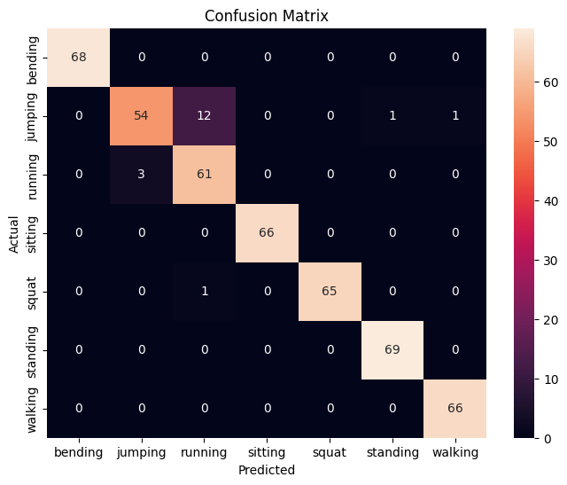
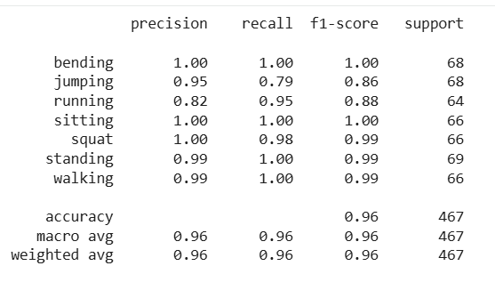
Results for Window-wise split
Accuracy = 96%

Slide 6
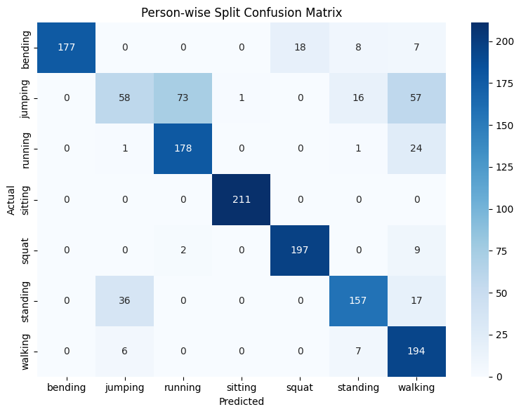
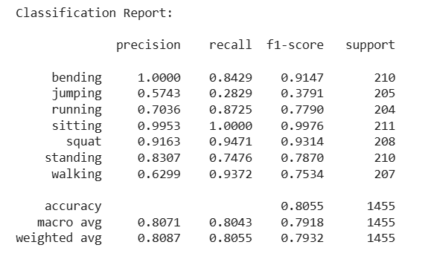
Results for Person-wise split
Accuracy = 80.50%

Slide 7
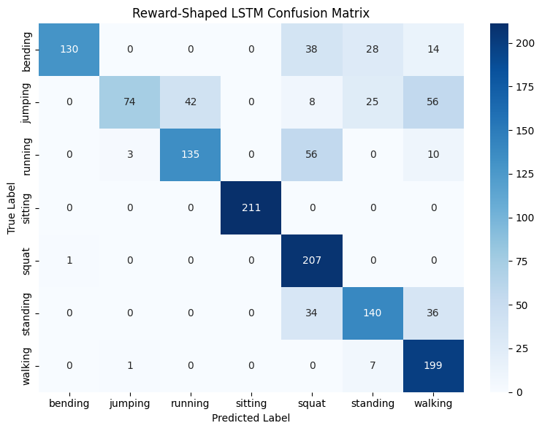
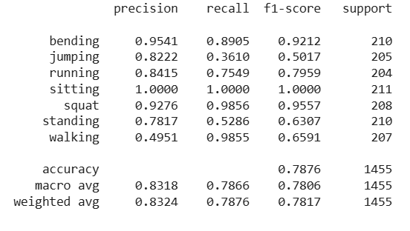
Results for Person-wise split + Reward Shaping
Accuracy = 78%

Slide 8
Observations on Reward Shaping
1)Improves Difficult Classes
Helps the model learn challenging activities more effectively.
Example: Jumping Recall improved from 28.3% to 36.1%.
2) Focuses on Important Errors
Instead of treating all errors equally, the model focuses on critical mistakes.
Example: Extra penalty applied for Jumping → Running and Jumping → Walking.
3) No Model Modification Required
Improves learning behaviour without changing the network architecture. Only loss function is modified.

